Slide 1
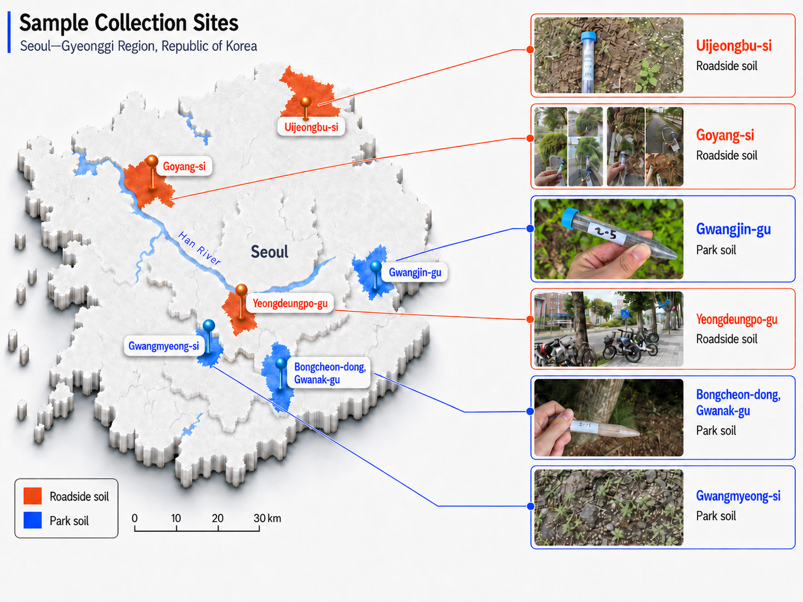
Figure. Sample collect

Slide 2
Figure. Taxonomic

Slide 3
Figure. Alpha diversity
A
Observed
Chao1
ACE
60
60
60
40
40
40
Observations
Observations
Observations
20
20
20
0
Soil
Park Soil
0
Soil
Park Soil
0
Soil
Park Soil
B
Shannon
Simpson
Fisher
4
1.0
1.0
3
0.8
0.8
Observations
Observations
Observations
2
0.6
0.6
1
0.4
0.4
Soil
Park Soil
Soil
Park Soil
Soil
Park Soil
Soil
Park Soil

Slide 4
Figure. Beta diversity
A
Bray-Curtis Index
Jensen-Shannon Divergence
Jaccard Index
0.6
0.50
0.25
0.3
0.25
[14.8%]
0.0
[20.9%]
0.00
[10.1%]
0.00
-0.3
-0.25
-0.25
-0.6
-0.50
-0.50
-0.4
0.00
0.4
-0.4
-0.2
0.0
0.2
0.4
-0.4
0.00
0.4
[20.7%]
[26.3%]
[14.9%]

Slide 5
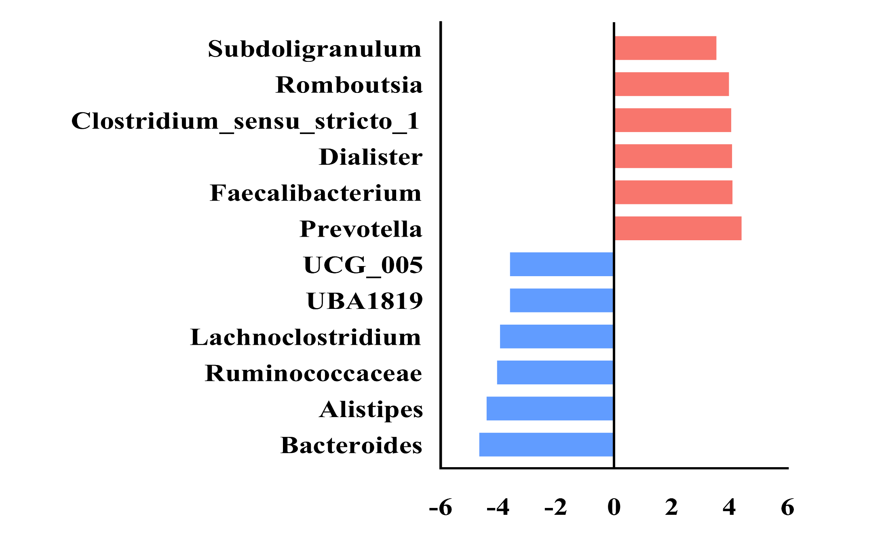
Figure. Lefse (soil vs park soil)
Subdoligranulum
Romboutsia
Clostridium
Sensu stricto 1
Dialister
Faecalibacterium
Prevotella
Features
UCG_005
UBA1819
Lachnoclostridium
Ruminococcaceae
Alistipes
HC
Bacteroides
OVCF
- 6
- 4
- 2
0
2
4
6
LDA Score

Slide 6
Figure. Taxonomic

Slide 7
Figure. Alpha diversity
A
Observed
Chao1
ACE
90
90
100
80
80
80
Observations
Observations
Observations
70
70
60
60
60
50
50
Poor
Good
Poor
Good
Poor
Good
B
Shannon
Simpson
Fisher
4.2
0.98
20
18
4.0
Observations
Observations
Observations
16
3.8
14
0.97
12
Poor
Good
Poor
Good
Poor
Good
Poor
Good

Slide 8
Figure. Beta diversity
A
Bray-Curtis Index
Jensen-Shannon Divergence
Jaccard Index
1.0
1.0
0.5
0.4
0.5
[19.4%]
0.0
[23.2%]
0.0
[16.2%]
0.0
-0.5
-0.4
-0.5
-1.0
-1.0
-1.0
-0.5
0.0
0.5
1.0
-0.4
0.0
0.4
0.8
-1.0
-0.5
0.0
0.5
1.0
[34.1%]
[40.2%]
[26.1%]

